Slide 1


EXPORTING
TO FRANCE
HOW TO MAXIMIZE EVERY SALES OPPORTUNITY
READ THE FULL GUIDE HERE!

Slide 2


CONTENTS
Market Overview
Market Data
Consumer Habits
Entering the market
    The Challenges
    The Solutions and Strategy

Slide 3

MARKET OVERVIEW
WHY FRANCE?
Is France on your export radar yet? It’s one of Europe’s e-commerce heavyweights – sitting behind only Germany and the UK in terms of numbers of users¹.
In fact, in 2022, more than 8 out of 10 French internet users bought something online².
Interested yet? All you need is an international shipping partner and some local market knowledge and your business will be good to go!
Read on as we explore the consumer insights and customs knowledge you need
to export to France.

Slide 4

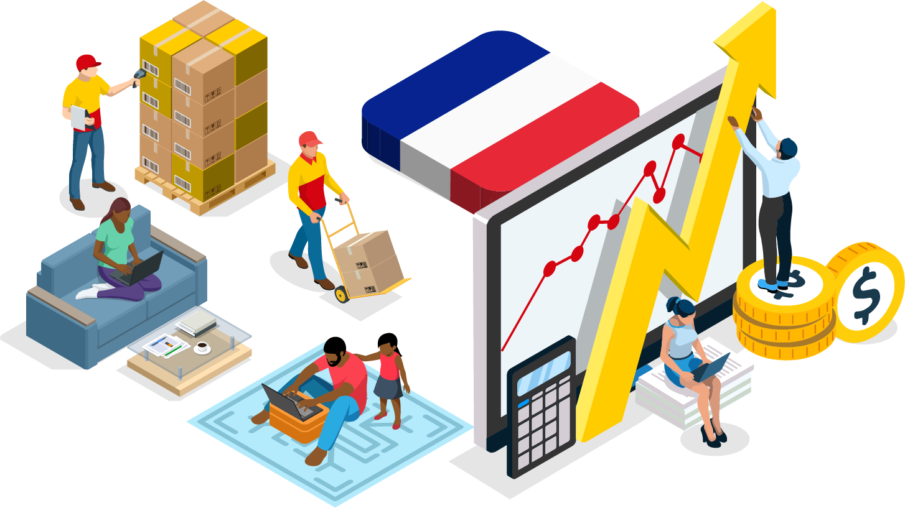
E-COMMERCE IN FRANCE
MARKET OVERVIEW
+14% e-commerce rise in one year
Between 2021 and 2022, online sales revenue in France grew from €129 billion to €146.9 billion³.
A rising e-commerce penetration rate
France has a population of 64.8 million⁴, and over 28.1 million e-commerce users⁵. This is forecast to grow to 32.7m by 2026.
Fueled by young buyers
In 2022, nearly nine out of 10 French consumers aged 25 to 29 years old shopped online⁶.

Slide 5
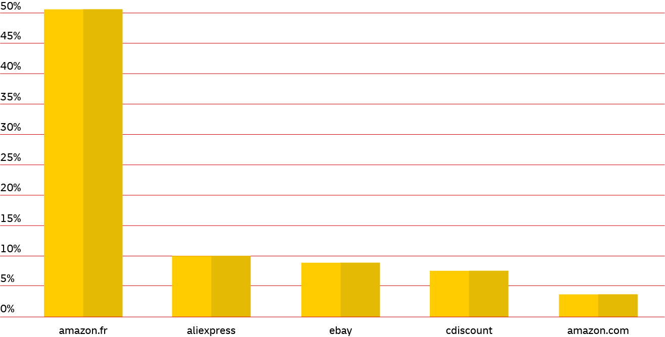
MOST VISITED MARKETPLACES
CONSUMER HABITS
Online marketplaces can be a helpful gateway for cross-border businesses wishing to sell to a new country for the first time.
Most popular online marketplaces in France in April 2023, by share of visits⁷

Slide 6
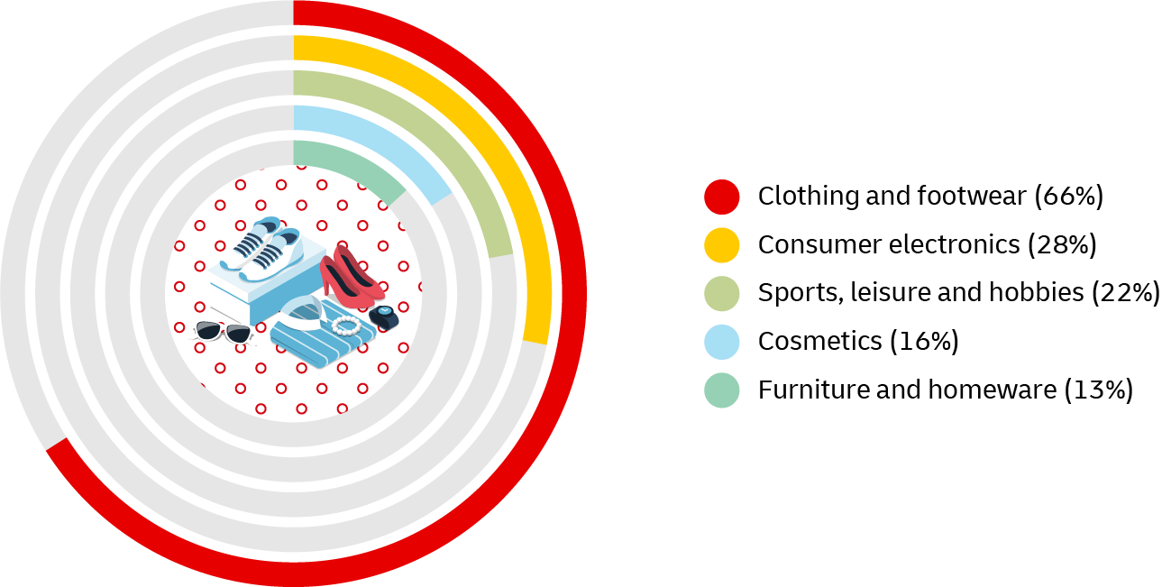
WHAT ARE FRENCH CONSUMERS BUYING?
CONSUMER HABITS
In 2022, around two-thirds of French online shoppers reported buying clothes and footwear from abroad. In comparison, only 13% of online shoppers bought furniture and homeware from cross-border retailers.
Cross-border e-commerce purchases in France in 2022, by product category⁸

Slide 7
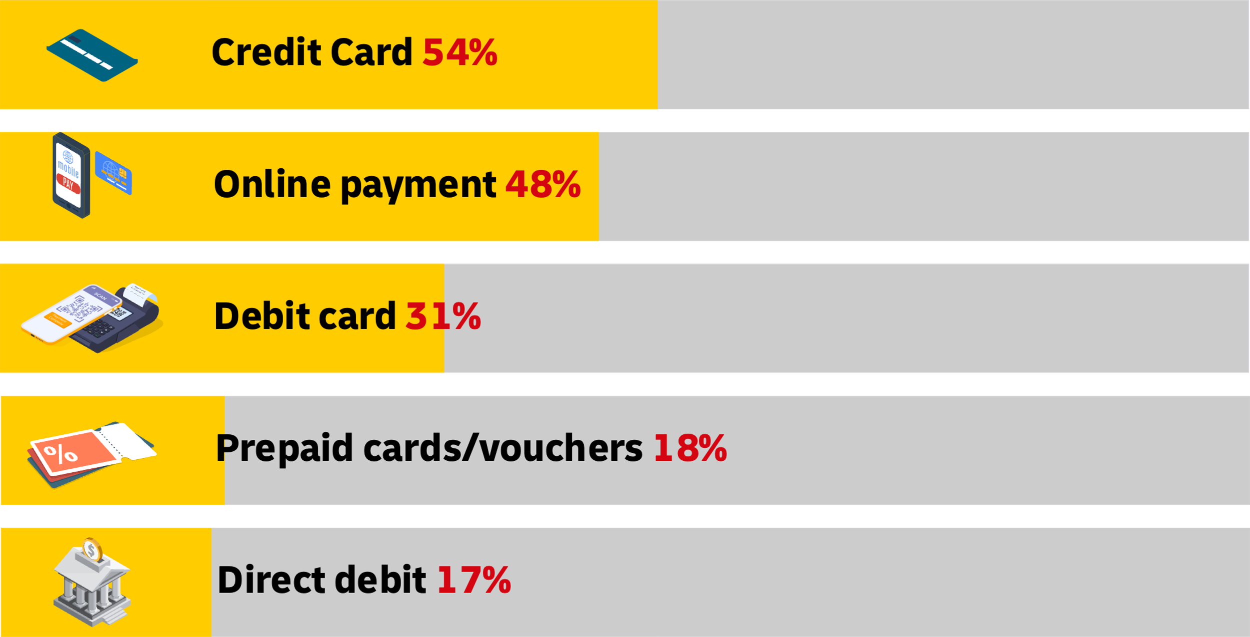
POPULAR PAYMENT METHODS
CONSUMER HABITS
Most popular payment methods in France in 2023⁹

Slide 8

FRENCH SHOPPING HOLIDAYS
CONSUMER HABITS
Understanding the key shopping events and holidays in France
is crucial for maximizing your e-commerce sales. Here are some important dates to mark in your calendar:
Valentine’s Day: February 14
Mother’s Day: May 26
Father’s Day: June 16
Amazon Prime Day: July
Black Friday: November 29
Cyber Monday: December 2
Christmas: December 25
Find out more here

Slide 9

ENTERING THE MARKET
KNOWING THE LOCAL MARKET
CUSTOMS AND IMPORT REGULATIONS
Customs duties are payable from €150 of value. Since 1st July 2021, VAT is applied to all goods imported into France from non-EU countries.
As a member of the European Union (EU), France follows EU trade policies, which generally involve low or no
tariffs for goods originating from other EU member states. However, import tax may still apply to goods imported
from outside the EU. The specific rates and regulations
vary depending on the type of product being imported.
It is essential to determine the correct tariff classification and consult the French Customs authorities or a customs broker to ensure compliance with import tax requirements.
Despite these challenges, France has a well-developed infrastructure and efficient customs processes, making it straightforward to import goods compared
to some other countries. Additionally, the French population is generally open to international products and trade, making it an attractive market for exporters.

Slide 10
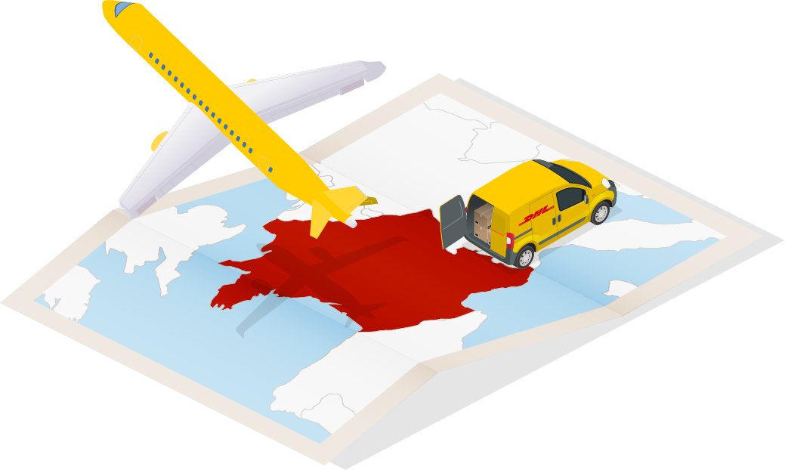
ENTERING THE MARKET
KNOWING THE LOCAL MARKET
EXPORTING TO FRANCE
Customers who do not have a duties and taxes account are systematically contacted when their import has a declared value greater than €5,000 in order to confirm payment of duties and taxes (unless sent by DDP).
Since March 2014, duties and taxes exceeding €1,000 will be billed to the customer after delivery. Cash advance fees are applied to import into France on DAP shipments in the amount of 2% of the amount of duties and taxes (with a minimum of €14.55 excluding tax or €17.50 including tax): these fees do not apply to DDP shipments.
BtC commercial traffic for import into France: for sales to individuals with a value of less than €150,
the seller has, since July 1st 2021, the possibility of invoicing the buyer for VAT at the time of the sale, then pay the tax authorities monthly by being registered on the Import Single Window (IOSS).
By indicating your IOSS number on AWB and invoice, VAT will not be collected at the time of importation. The IOSS number is valid for all EU countries. Goods subject to excise duties (alcohol, tobacco) do not fall under the IOSS regime.

Slide 11
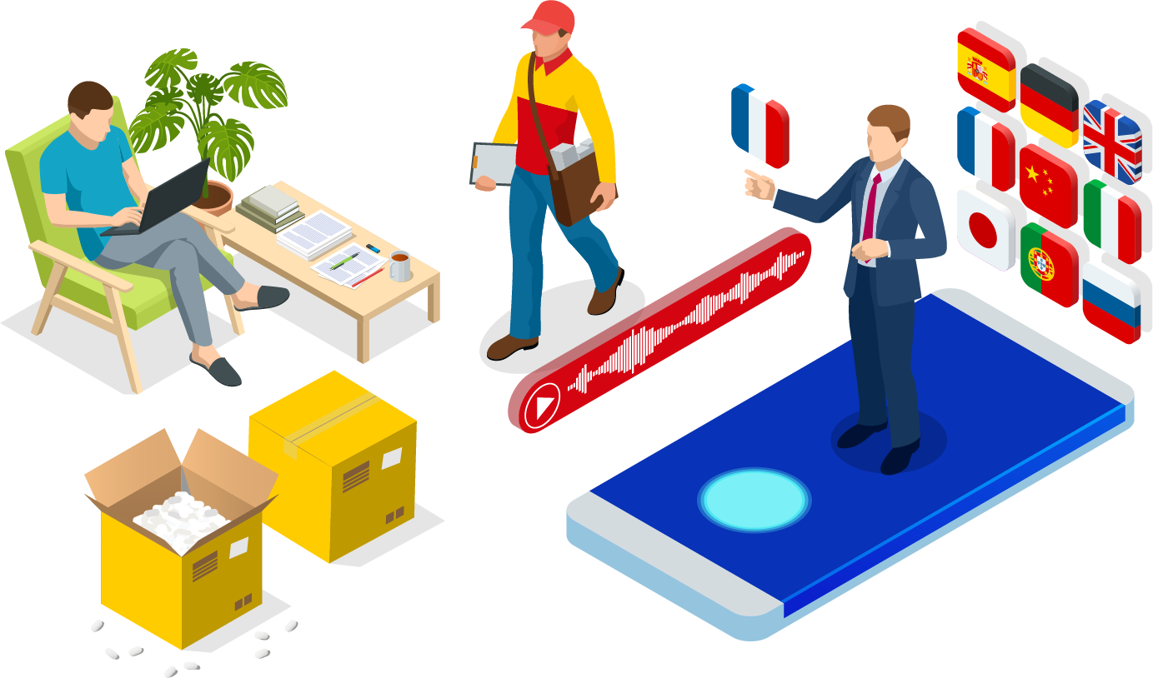
ENTERING THE MARKET
THE STRATEGY
Translate your website into French to attract shoppers – and be sure to display prices in the local currency too.
61% of French online shoppers said they will abandon
their carts if not offered their preferred delivery option
at checkout¹⁰. By offering On Demand Delivery, you can give them full flexibility and convenience – and ensure
they return to your business again!
Register with DHL Express’ MyGTS (My Global Trade Services), a free, user-friendly platform that will help you navigate all aspects of international shipping, seamlessly. Find your goods’ HS codes, get a Landed Cost calculation, and receive guidance on France’s import restrictions
before you ship.

Slide 12

REFERENCES
Statista, August 2023
Statista, June 2023
Statista, August 2023
Worldometer, December 2023
Statista, November 2023
Statista, June 2023
Statista, June 2023
Statista, May 2023
Statista, November 2022
DHL European Online Shopper Survey, 2023

Slide 13


THANK YOU
Discover
Delivered by DHL

